Slide 1

User App User Guide

Slide 2
From Kendy
Second one is the Trainer App, this allows connection of multi-bands and export of their data in csv format. For example, in a mindfulness training classroom session, trainer can connect all the bands to view the reports of all the participants in real-time. The training data is supposed to be taken under static condition, without any motion, therefore, meditation/guided breathing are the suggested scenarios.
The training mode can be turned on by:
(i) Starting any audio programs in the User App
(ii) Tapping “Self-Training” in the User App
(iii) Tapping “Start” in the Trainer App (P.3 of the Trainer App user guide)
(iv) Start manually (P.6 of the Prototype user guide)
To export the HRV and breathing data collected in the training sessions, please refer to P.11 of the Trainer App user guide.
If you want to download the data of the wristbands from the cloud, so that you can get access to the users’ data remotely:
The users need to install the User App in their devices;
Please check and provide the MAC addresses of all the wristbands;
We will provide the access code;
Refer to P.8 of the Trainer App user guide to access the cloud data

Slide 3
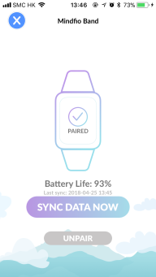
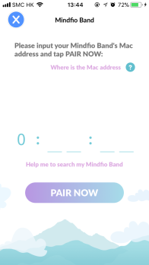
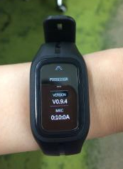
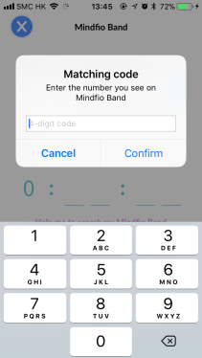
Pairing
1. Enter the serial no.
2. Enter the 4-digit number appears on the wristband’s screen
3. Tab to sync data

Slide 4
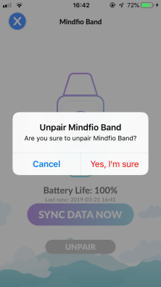
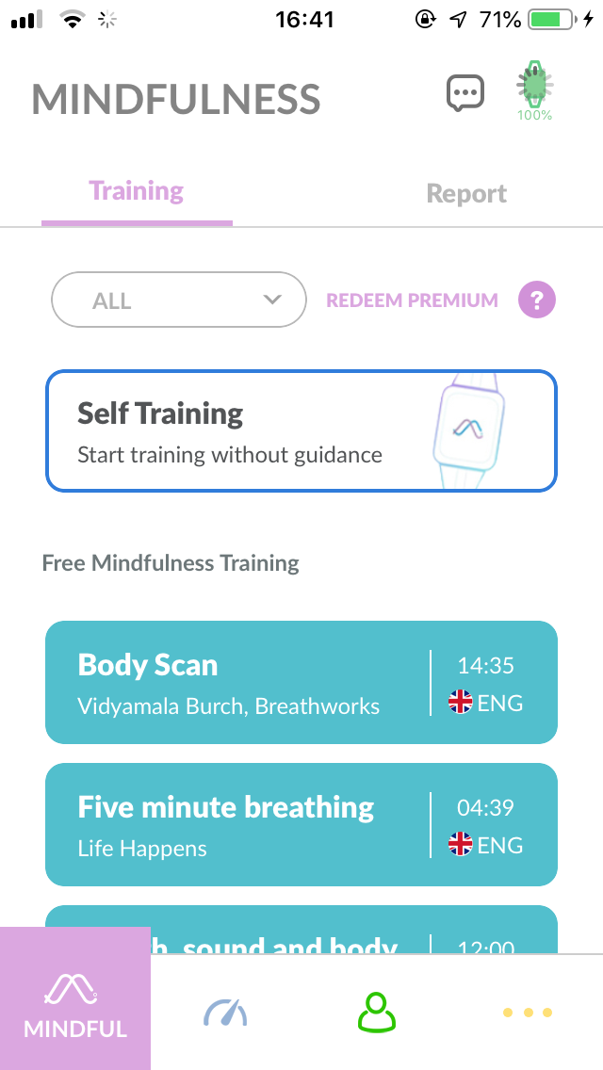
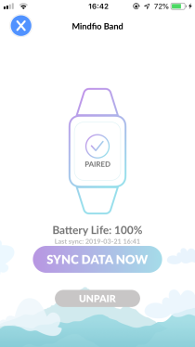
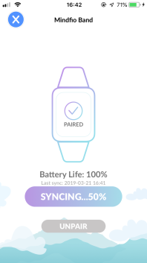
Synchronization
1. Once the band is paired, the app will sync the data automatically.
2. You may tab this icon to view the syncing progress
3. Once synchronization is completed, it is suggested to unpair the band.
4. Tab to unpair, then confirm it.

Slide 5
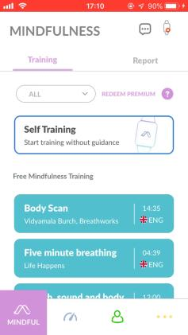
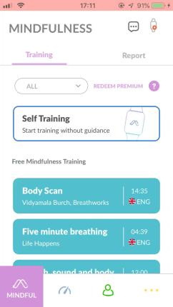
Reports
Daily Stress Report
Program Training Report
Play
Play

Slide 6
Appendix
There are researches on the scientific study of emotion that emphasizes the importance of coherence as an optimal psychophysiological state.
A fundamental order in heart-brain interactions and a harmonious synchronization of physiological systems are associated with positive emotions.
Mindfio Index is presented in correlated with the coherence ratio.
Coherence ratio | Mindfio Index | Coherence ratio | Mindfio Index
10 | 97.8 | 0.8 | 65.0
6 | 96.0 | 0.7 | 61.0
5 | 95.0 | 0.6 | 56.0
4 | 93.3 | 0.5 | 50.0
3 | 90.0 | 0.4 | 40.0
2 | 83.0 | 0.3 | 30.0
1.5 | 78.0 | 0.2 | 20.0
1 | 70.0 | 0.1 | 10.0
0.9 | 68.0
Mindfio Index
No data
0-49
50-69
70-89
90-100

Slide 7
FAQ
I cannot connect the MindfioBand with Mindfio App though the Bluetooth is on.
Sometimes the wristband is hooked up by the mobile itself. You can turn off the Bluetooth and close the
Mindfio App completely, then re-try.
How to wear the MindfioBand.
To get accurate readings, the MindfioBand should be laid flat, a finger's width above your wrist bone. For better readings during fast movements, it is recommended to wear the band about 2-3 finger widths above your wrist bone.
No readings when wears the MindfioBand on inside the wrist.
It is not recommended to wear it on inside the wrist because it is programmed to read the blood vessels on the outside. As with all heart-rate monitoring technology, accuracy is affected by personal physiology, location of wear, and type of movement.

Slide 8
FAQ
I wear the wristband tight.
Do not wear your wristband too tight; a tight band restricts blood flow, potentially affecting the heart rate signal.
I do not see the breathing curve in the chart of training session.
Breathing data is only measured when you sit still with no hand movements.
I do not see any reading after the training session.
HRV is inaccurate if you have big movements during the training session, therefore no analysis is provided.
The wristband keeps vibrating.
You can stop the vibration by connecting the wristband with the charging cable to reset it.

Slide 9
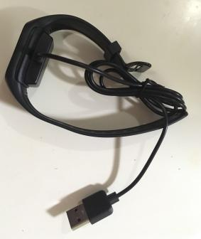
FAQ
I still see data in the App even I did not wear the wristband during that period of time.
This is the shortcoming of the current prototypes that false data is still collected even the user is not wearing
the wristband. The tentative measure is to cover the LED of the wristband with the base of the charging cable
without plugging the USB plug.

